Slide 1

Amazon Alexa Prize Team Discussion
May 2nd , Thursday

Slide 2
Welcome
Agenda
Team Introduction
About the competition
Important Take-aways from the Alexa Prize Roadshow
Discussion of Approaches
Finalization of Approach
Work Assignment
Setting timelines

Slide 3
The Amazon Alexa Roadshow
Available on the Prize Website
Talks about the contest and the approaches + suggestions made by Amazon based on Experiential Learning
Important Video: https://www.youtube.com/watch?v=QC5D_felHCs&feature=youtu.be
Learnings

Slide 4
Learning 1
How to keep the conversation
Fun and Engaging
Knowledge Based – Grounded
Dialogue
Topical Suggestions – Should be able to follow it up
Topical transition (Very Important)
Deciding when to make a topical transition
Keep in mind how to handle noisy inputs.
Profiling people
Using opinions based approach but don’t be personal means don’t say I think until sure that you can handle that.
Don’t Repeat

Slide 5
Learnings 2 - Scientific
Explore BERT (+ Ensemble models)
How to choose a response from candidates:
Rank based on
Response Diversity,
Interestingness, and
Correctness
Previously used Ensemble Models:
Retrieval based models,
Template Driven, and
Response Generators
Graph based + Unstructured data go hand in hand
Video after 27.40 minute

Slide 6
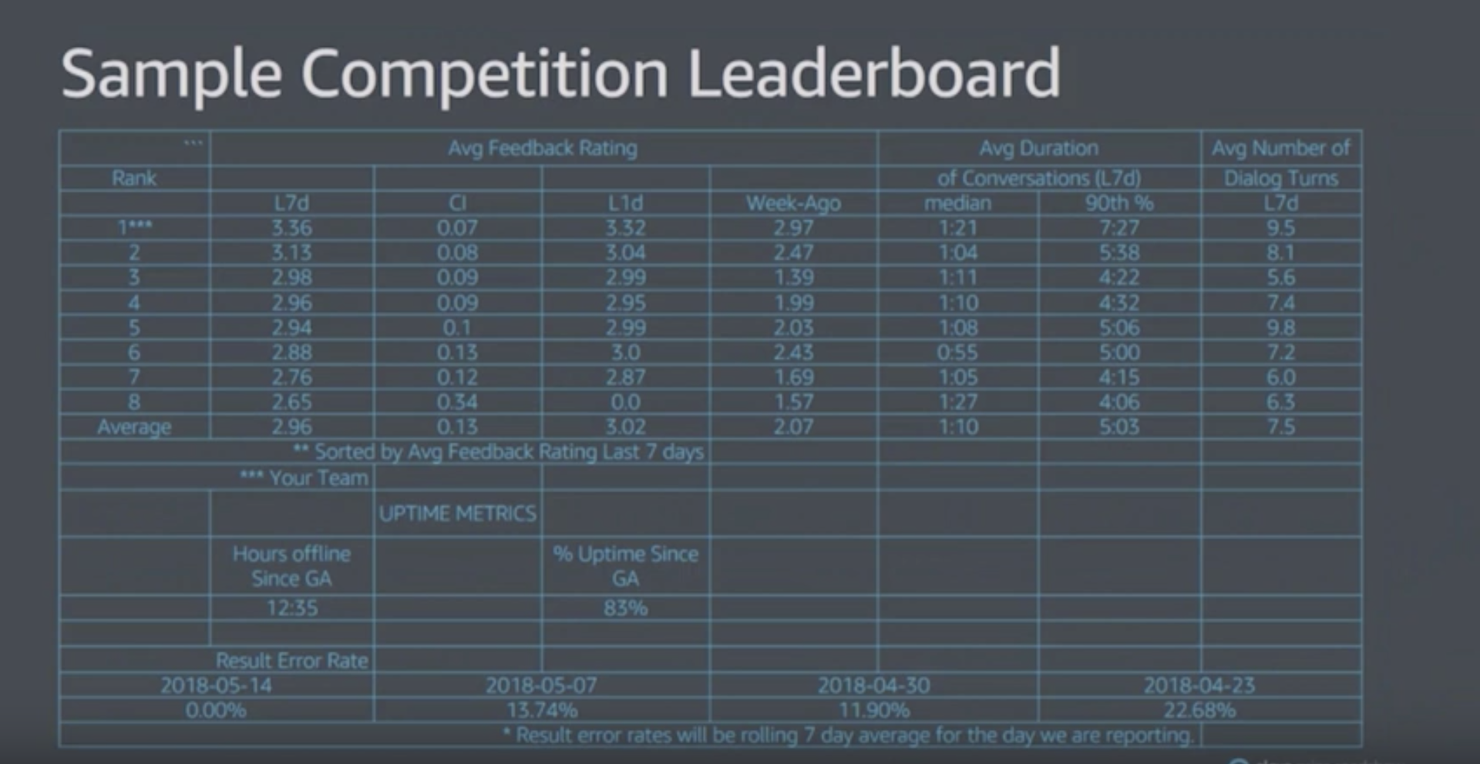
Metrics of measurement: Sample

Slide 7
Ideas
See Responses for Google Forms - https://docs.google.com/spreadsheets/d/1Bqr9VpTetvJyT6fVB0OuHZtCwutSO_pZlxiasRhnbQQ/edit#gid=325714093

Slide 8
Discussion on the Approaches
Finalization of Approaches
Summary of Approach
We create five modules for our socialbot namely, Dialog Simplifier/Summarizer, Knowledge Graph traversal, Topical Association Classifier, a Conversation Quality Indicator (Red – Flag Manager) and an Alexa Profile Manager.
The expected flow of conversation would be as follows:
“We start the conversation with few usual questions and try to figure out a suitable profile for Alexa that reflects the User’s emotions, then we go ahead with that profile during our conversation (building profiles may help us making expected transitions during the conversation). During every dialog (Alexa:…… , User: ……….) we traverse the textual knowledge graphs to select for candidate answers to the user question/request. The text simplifier/ summarizer runs every time Alexa says something. We model a conversation quality indicator that after every dialog, assess the quality of the conversation (good or bad – this system learns to evaluate user dialogs). If the conversation quality drops below a cushioned threshold, we start using the Topical Association Classifier which identifies the best topic to make transition to based on Association rule mining (the Association rule mining will use the context/ intent/ topic label to perform this analysis). On top of all this sits a Super Manager that learns what to do based on the conversation quality indicator. It decides if we shall continue the same topic or make a transition or switch the Alexa profile. ”

Slide 9
High Level Expectation from Each Module, and Work Assignment
Module | High Level Expectation | Owner
Amazon Profile Manager | Pre trained set of profiles that associate user interests to either of the profiles and helps the socialbot build an expected flow chart of the conversation | Tiana
Text Simplifier | This module simplifies the language of the conversation and also uses Coreference to make the user feel for comfortable. It must be able to remember user answers to avoid asking repetitive questions. | Piyush
Knowledge Graph Traversal | The module traverses through the knowledge graphs to figure out the correct and appropriate responses to users questions. It decides if it should make a factual answer (through encyclopedia’s / Google KG) or bring forward an opinion (from reviews/ comments/ conversations on social media channels) | Nikhil
Topical Association | Evaluates the context of the conversation when triggered and classifies associated topics for suggesting transitions to the user | Deepali
Conversation Quality Evaluator | Evaluates the conversation quality after every dialogue. | Dipesh
Super Manager | Uses the Conversation Quality value to decide if there is a need dive deeper into a topic, suggest a topical transition or worst – case switch entire Alexa profile during the conversation | Yash

Slide 10
Timelines
The approaches (ML, NLP, NLU technique) to create every manager are still not finalized (though we have some content for most modules in previous papers by Amazon). So we finalize the model to be used by each manager module along with a feasibility check by
- Monday, 6th May 2019
Every member submits the technical design and flow through their module in detail along with flow graphs and dependence graphs (if possible) by
- Thursday, 9th May 2019
Preparation of the consolidated paper
- Saturday, 11th May 2019
Application review and submission
- Monday, 13th May 2019
Important Node: The application will ask for a Bio of each applicant and Faculty Advisor after we submit the technical approach. So we will have two days after 11th May to complete the application. Please have your resume’s and a 100 word bio ready.

Slide 11

Thank You

